Slide 1
An Overview of
TURKISH
DEFENCE INDUSTRY
M. Kaya YAZGAN
Secretary General
Defence & Aerospace Industry Manufacturers Association

Slide 2
TURNOVER

Slide 3
EXPORT

Slide 4
R&D EXPENDITURE

Slide 5
Land Platforms
Naval Platforms
Aerospace
Electronics / Electro-optics / Electrical
Software and Information Technologies
Weapons – Ammunition / Rockets - Missiles
R&D and Engineering
Components – Parts
Uniforms – Boots - Accessories
Logistics

Slide 6
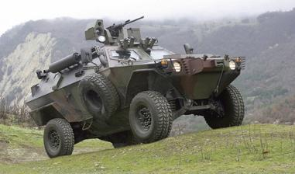
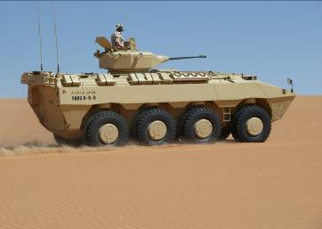
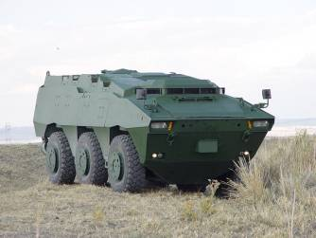
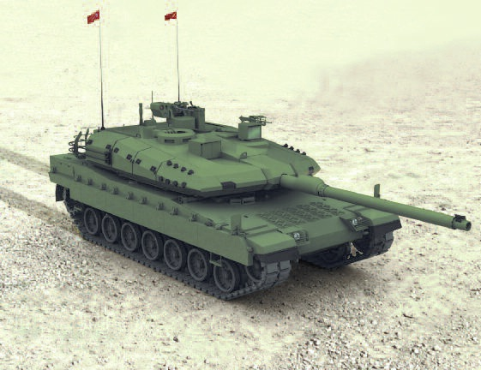
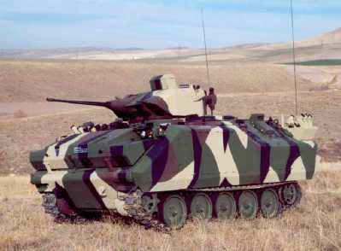
LAND PLATFORMS
Various Types of Land Platforms
All Over the World
Main Battle Tank
Design Program

Slide 7
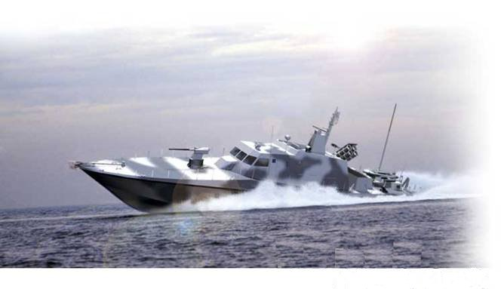
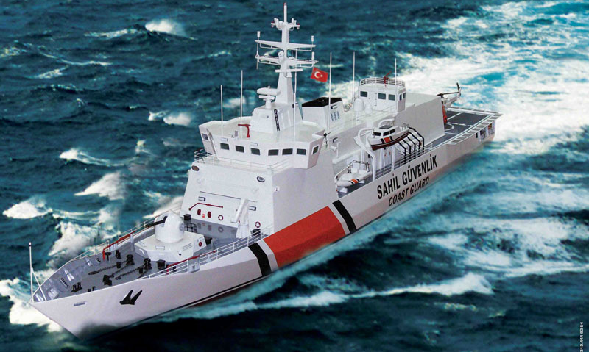
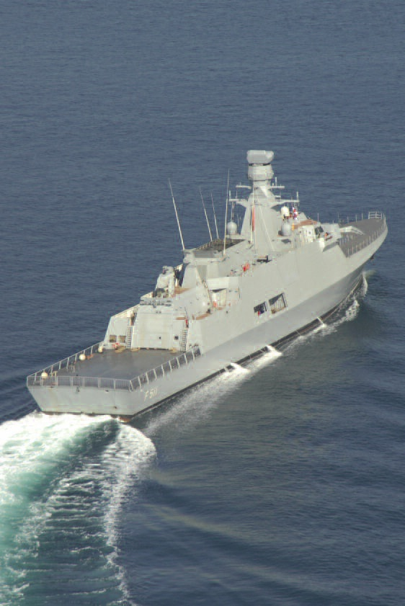
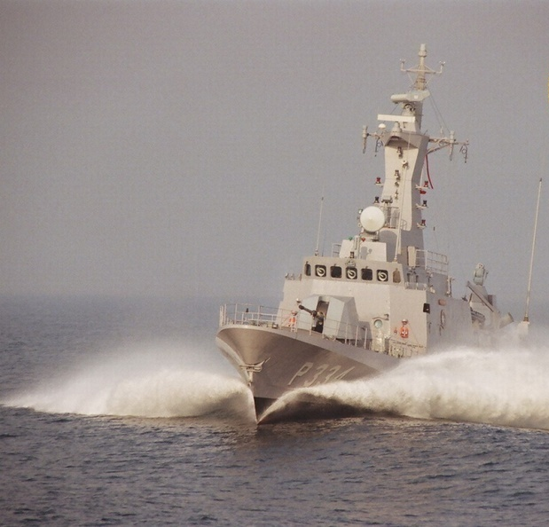
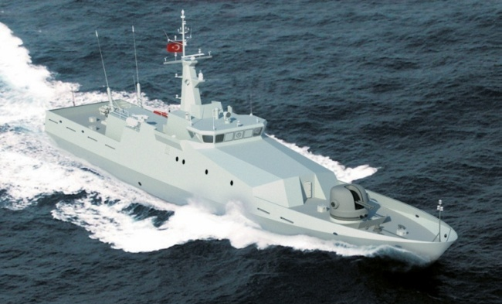
NAVAL PLATFORMS
MRTP, Patrol Boats, Search & Rescue Ships …
MILGEM Corvette

Slide 8
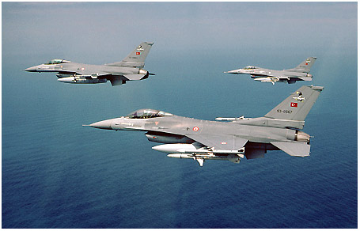
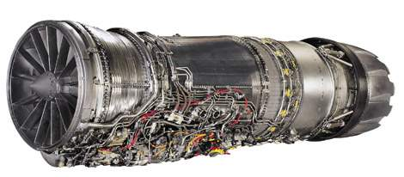
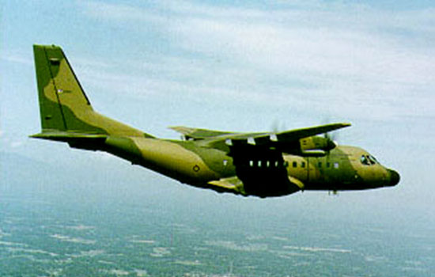
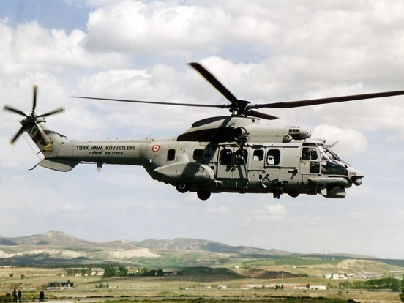
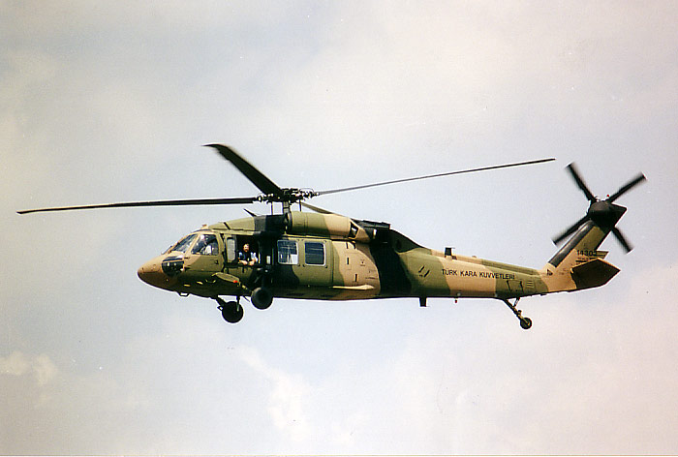
CO-PRODUCTION IN AEROSPACE
Alışveriş yaptığınız marketlerin neredeyse tamamı yabancıların.
Ne oldu büyük iş adamlarımız! İş bilip, dünya çapında kredi" sağlayıp, bu tesisleri kaptırmamayı deneyemediniz mi!
Efforts Started with Co-production Programs
F-16 / F110-Engine
CN-235
AS-532 (Cougar)
S-70 (Sikorsky)
AWACS

Slide 9
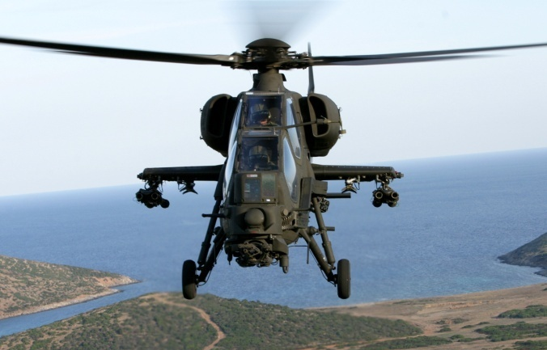
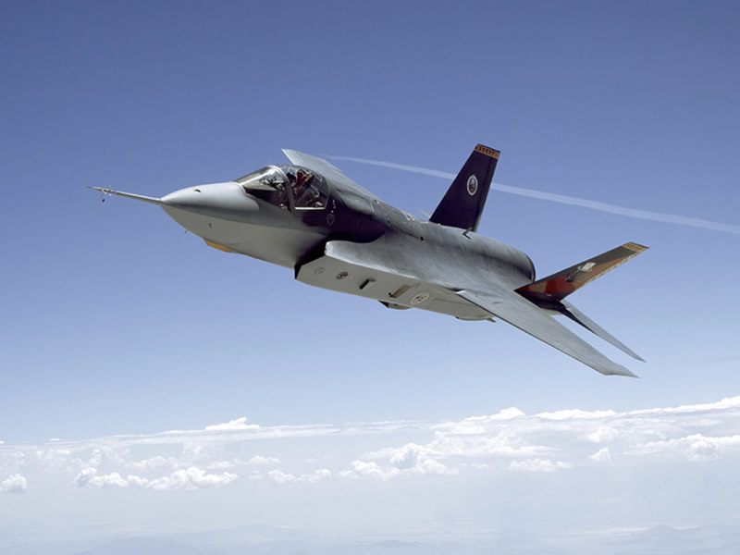
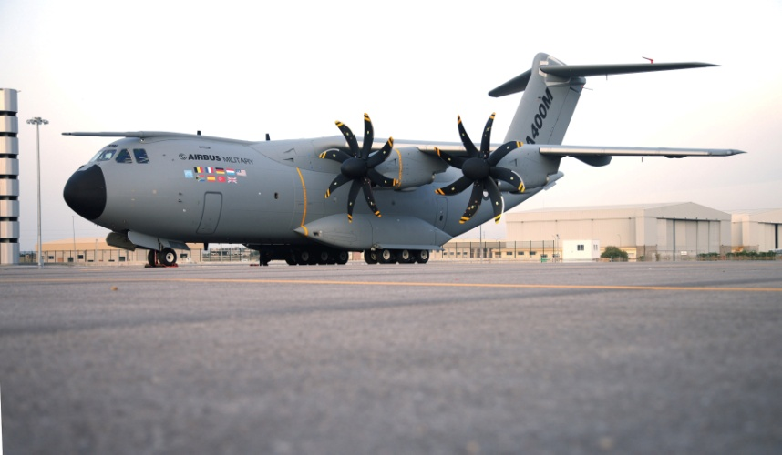
CO-DESIGN and CO-PRODUCTION IN AEROSPACE
Important partner in International Design and Production Programs
(T-129, F-35, A400 M)

Slide 10
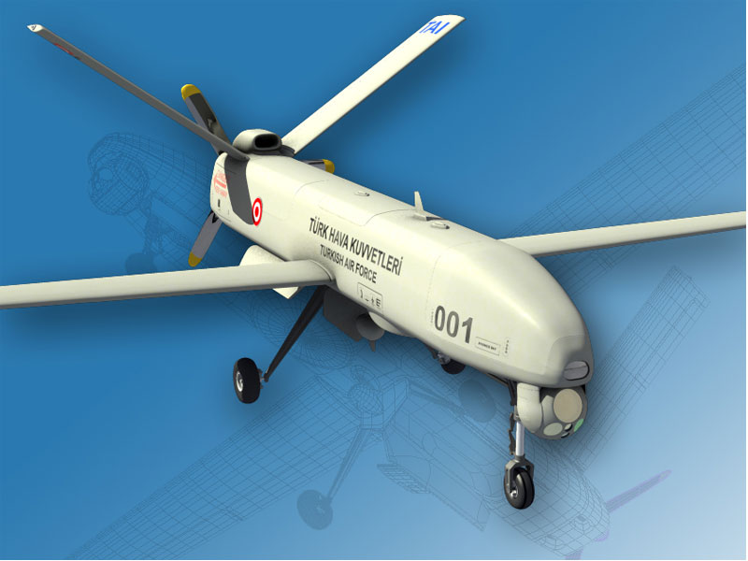
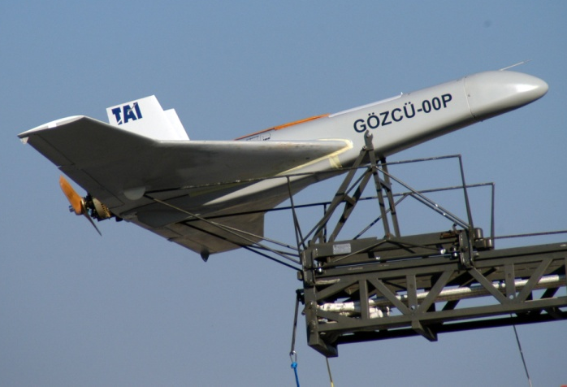
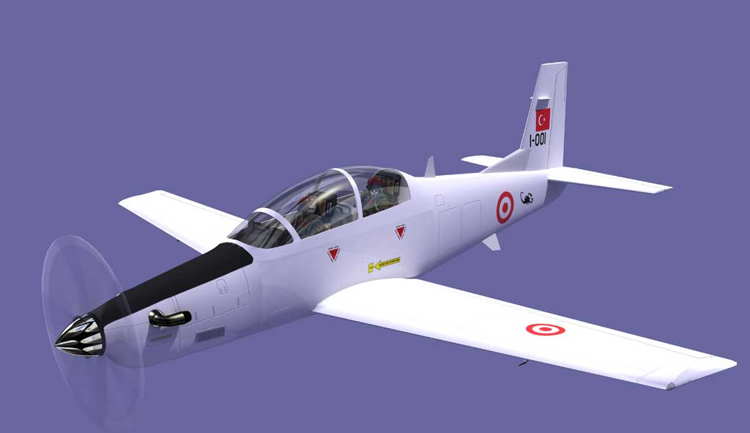
INDIGENEOUS PROGRAMS IN AEROSPACE
Unmanned Air Vehicles:
Mini
CR-Close Range
MALE- Medium Altitude Long Endurance
HÜRKUŞ
Primary and Basic Training Aircraft

Slide 11
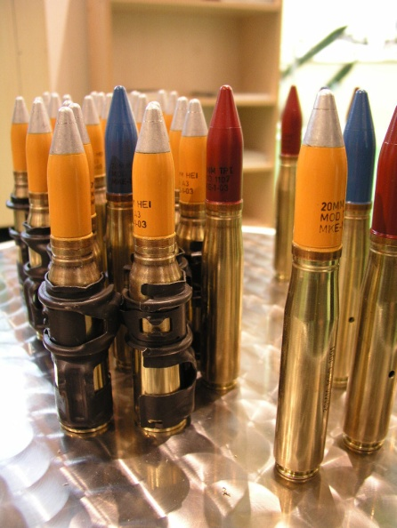
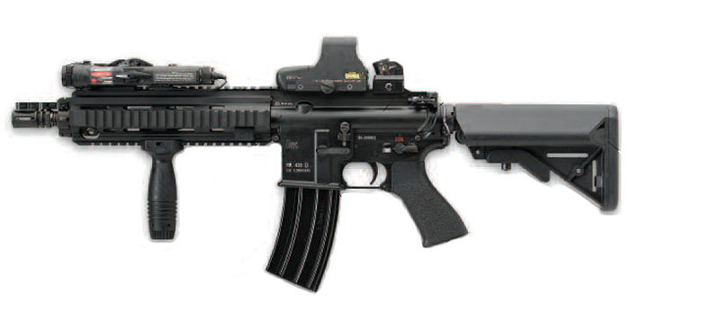
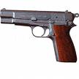
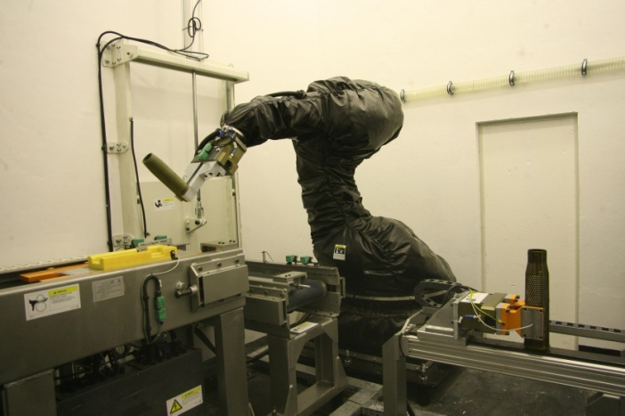
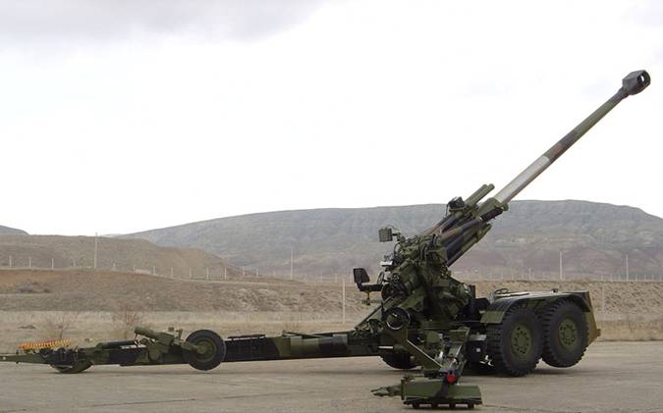
WEAPONS-AMMUNITION
Ammunition
Light weapons
Mortars and guns
Ammunition Disposal
Facility

Slide 12
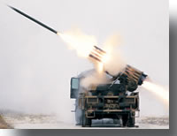
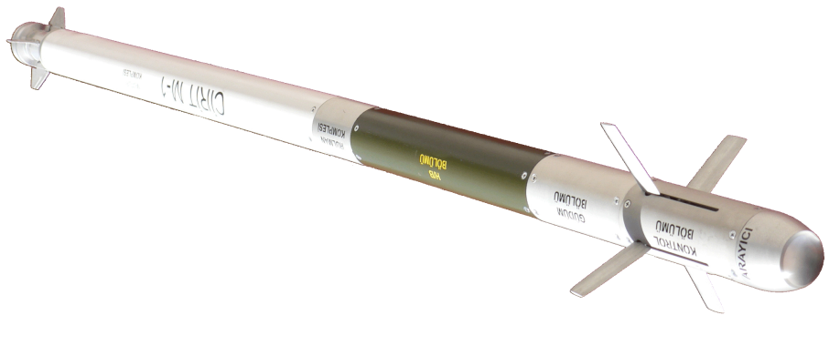
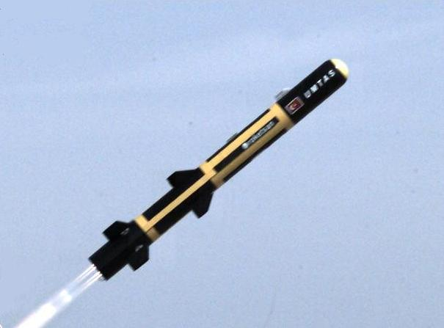
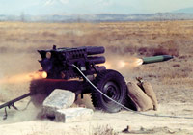
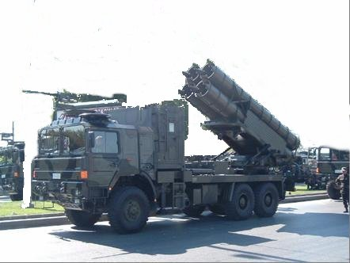
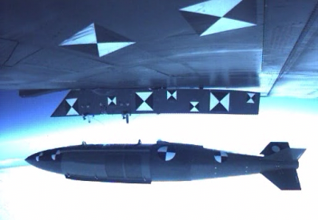
ROCKETS-MISSILES
Air to Ground
Anti-Tank Missile
Precision Guidance Kits for MK-84
Artillery Rocket Systems for Various Ranges

Slide 13
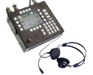
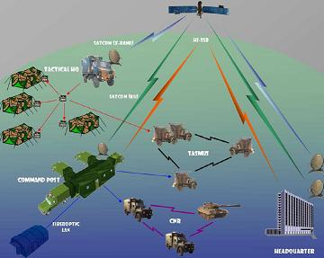
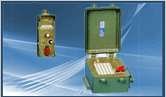
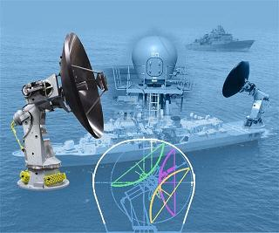
ELECTRONICS and COMMUNICATION
From Electronic Devices to Complete Electronic Systems

Slide 14
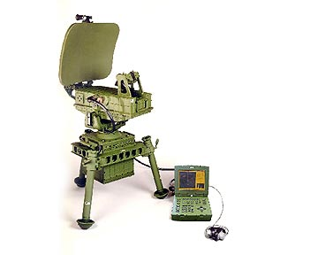
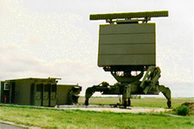
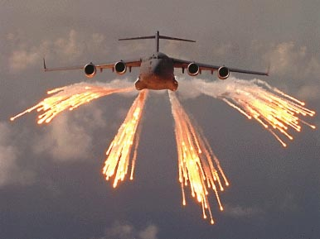
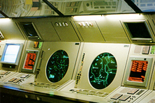
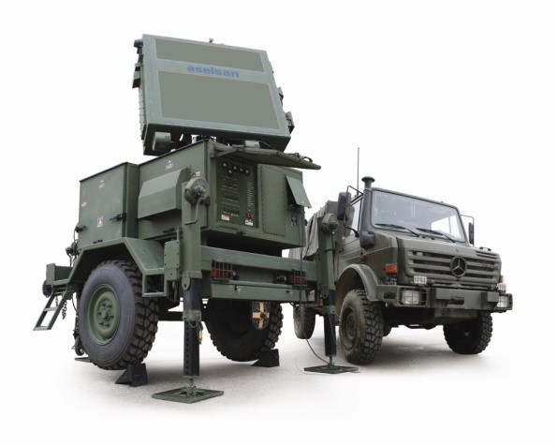
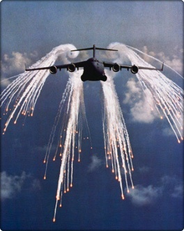
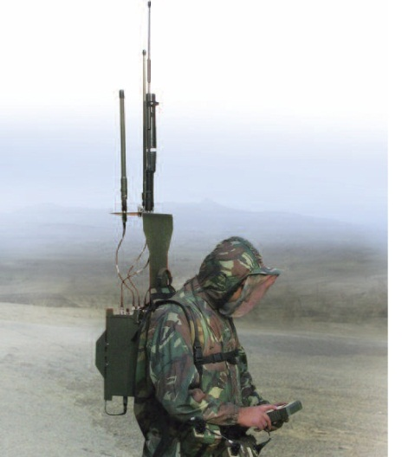
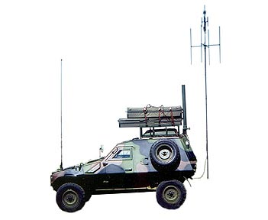
RADARS and ELECTRONIC WARFARE

Slide 15
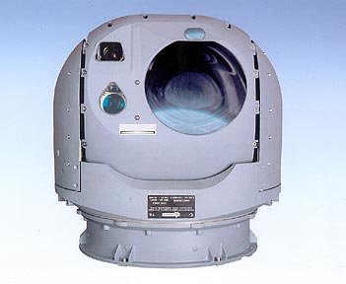
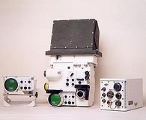
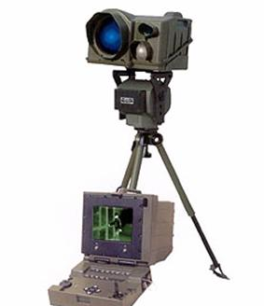
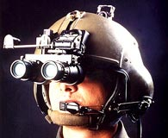
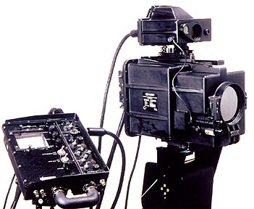
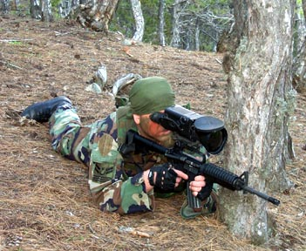
ELECTRO-OPTICS
Visible / Night Vision / IR / Thermal Sights
Thermal Cameras and Imaging Systems
Laser Range Finders and Designators

Slide 16
SOFTWARE and INFORMATION TECHNOLOGIES
Data Base and Data Flow Design and Implementation for Networks
War Administration Battlefield Management

Slide 17
SIMULATION and MODELLING
Fixed and Rotary Wing Simulators,
Simulation Centres
Vertical Wind Tunnel -Free Fall Training Simulator
Naval War-game Simulation System
Damage Control Simulator for Navy

Slide 18
DIGITAL MAPS and IMAGE PROCESSING
SAR, Image Processing, Fusion, Automatic Target Recognition

Slide 19
TRAINING
Soldier Training
Electronic Warfare Test and Training Centre

Slide 20
R&D and ENGINEERING
In addition to Design and Development Departments of Companies
Three R&D Institutes
Special R&D-Engineering Companies
TechnoPolises in Universities

Slide 21
UNIFORMS and ACCESSORIES

Slide 22
ELECTRICAL SYSTEMS
Power Supplies and Motors for Systems

Slide 23
COMPONENTS
Printed Circuit Boards
Cable Harnesses
Cases / Shelters
To Support Electronics
Thermal Batteries

Slide 24
MOULDS-DIES and MECHANICAL PARTS
Precession parts for:
Rotary and Fixed Wing Aircraft
Land vehicles and
Ships

Slide 25
LOGISTICS

Slide 26
Members/Associate Members
Clusters
(Aviation, Automotive, Marine, Sub-contractors…)

Slide 27
FURTHER INFORMATION
For Turkish Defence Industry:
www.sasad.org.tr
sasad@tr.net
For Major Programs:
www.ssm.gov.tr
For Modernization /
Current Procurement of Goods and Services:
www.msb.gov.tr

